Slide 1
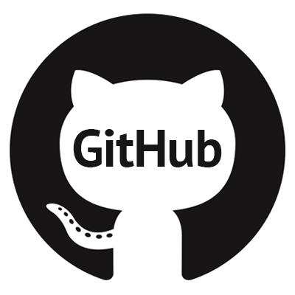

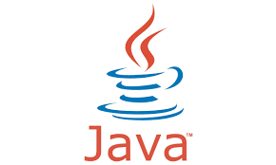
Lab Software and Version Control
Sean Howard

Slide 2
What Software Do We Use?
Gwyddion
Open source software written for SPM experiment visualization and data analysis
Has lots of nice features, modular with python scripting and API, does not have all the necessary functionality for our group now
Dan’s Java Code
Written by Daniel Walkup in Java for our STM analysis
Very specific to our needs, larger learning curve, has some bugs, hard to add new features, need to know code/java
Notes:
Gwyddion is an open source software written for and by SPM experimentalists. More similar to what you would expect software to be, can look at the code but would never need to. Deals mostly with two dimensional data, able to handle 3d data such as dI/dV but lacks a lot of data analysis processes on 3d data. Gwyddion has python scripting which allows you to use their API to add on functionality as you see fit, both in and out of their software.
Then there is Dans java code. It was his first attempt to learn java, and it shows in the structure of the code. Lots of bugs, which forces you to look at the code a lot which isn’t fun for a couple reasons. Has a lot of specific applications to our research, but difficult to figure out how to use those features. Data structures are a bit convoluted, hard to add on additional code.

Slide 3
Which Software Should We Use?
The One that Gets the Job Done!
But in either case we need to add on features or fix bugs.
If one person improves the code, we would like improvements to be distributed to everyone.
Impractical to keep on server and delete and download constantly. Several version of Java out there and many little specific programs .
How to Improve Code as a Group
Use Version Control!
Version Control allows for the management of changes and versions of a code base.
GitHub is a Version Control website based on Git, a VC system .

Slide 4
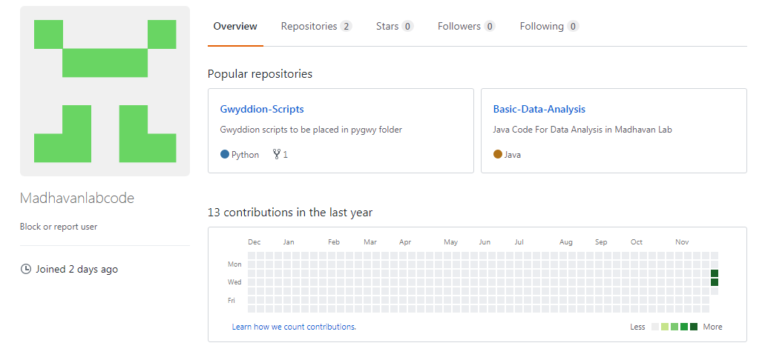
Starting to Use VC and GitHub
Lab GitHub account that hosts Gwyddion scripts and Java Code
Account is public (private accounts cost money), but changes to code must be approved by the lab account.
Anyone can contribute to the project, all they need is a GitHub account.
Small learning curve with Git nomenclature, but all can be done in a GUI. No command line necessary.

Slide 5
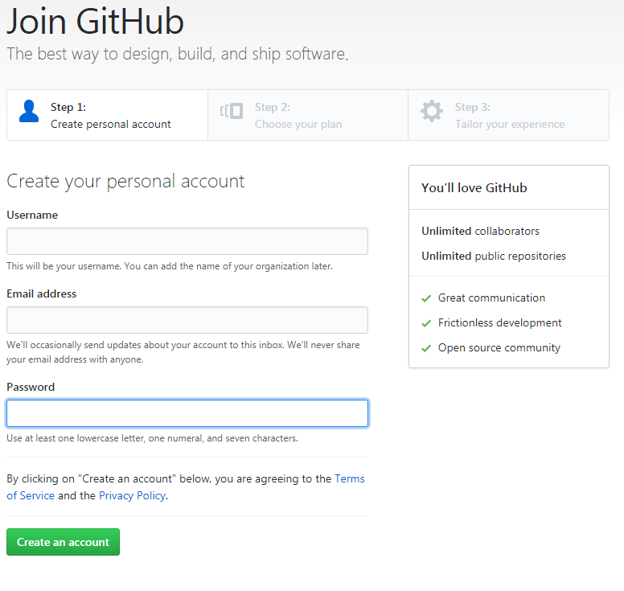
Getting GitHub
Go to GitHub’s sign up page and fill out the details. Easy!

Slide 6
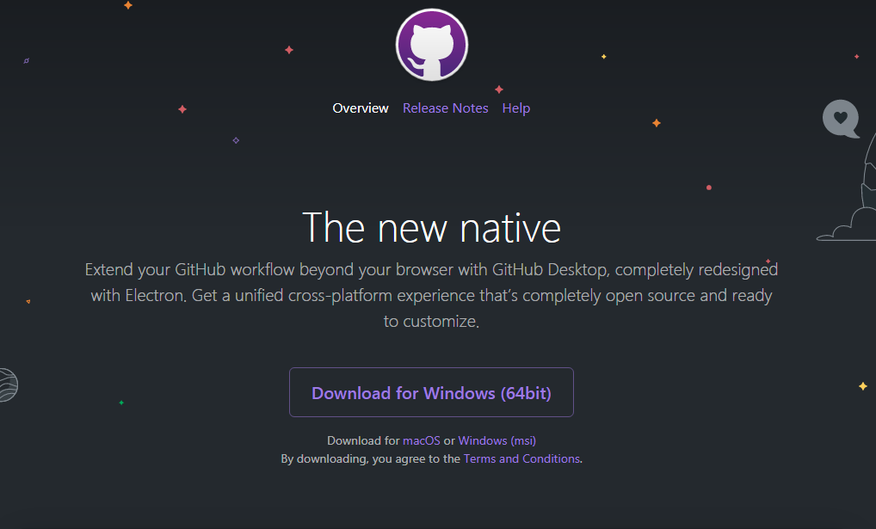
GitHub Desktop
If you want a nice user interface, download GitHub's desktop app. Otherwise, download Git and use the command line

Slide 7
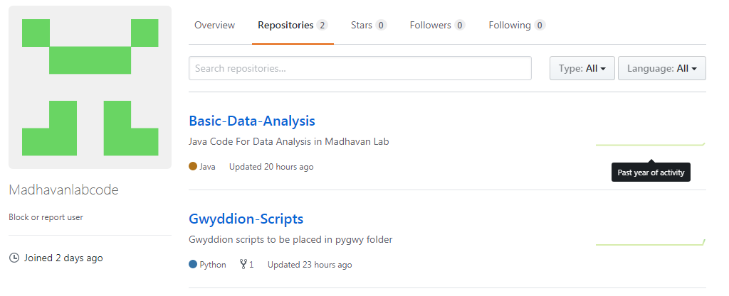
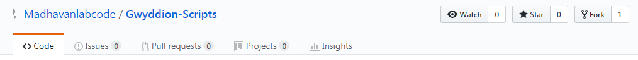
How to Get Code and Contribute
Projects are stored in Repositories, which are digital folders on GitHub which store all the files and changes.
To contribute to a project, go to the project’s page and Fork it. Forking a project creates a personal copy of the project on your account.
Notes:
Git has a structure in which projects are worked upon and updated. Using a UI can gloss over some of the learning curve of using Git and GitHub.

Slide 8
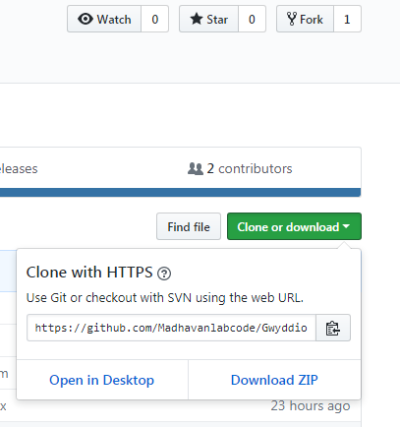
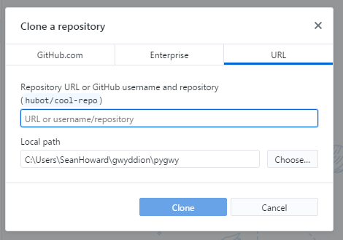
How to Get Code and Contribute
After Forking a project, you can Clone the project. Cloning the project allows you create a copy of the project on your computer.
If using GitHub Desktop, you can copy the HTTPS and specify which directory on your computer you would like to download the project.

Slide 9
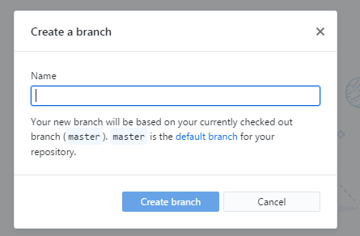
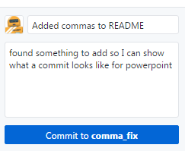
How to Get Code and Contribute
Once the code is downloaded and you wish to make changes, it is a good idea to uses Branches. Branches are parallel versions of the code that allow you to make changes while keeping a “master” version intact. If you’re fixing a bug, the Branch name could be bugfix_loading3ds etc.
Once you have made changes to the code, you can record these changes using Commits. Commits are like saving files in your local repository, with the added feature of being able to revert back to any previous Commit. It is a good idea to leave a comment describing the change.

Slide 10
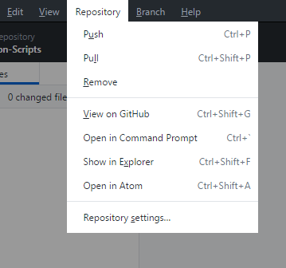
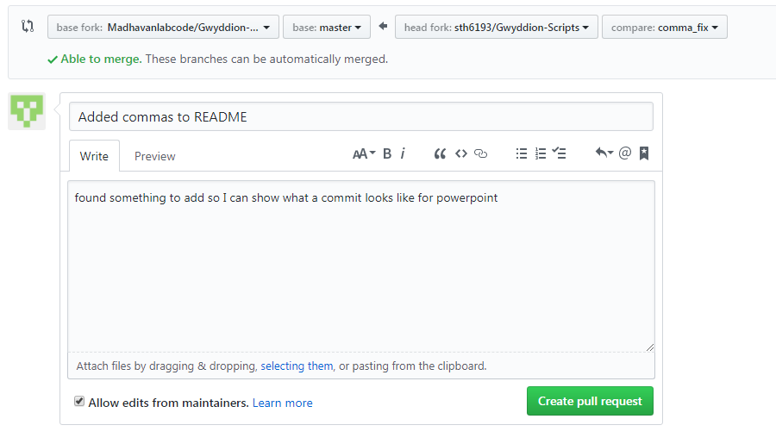
How to Get Code and Contribute
After making a series of Commits, you will want to update the your version of the code online. This is done via a Push. A Push sends your changes to your forked version online
Next make a Pull Request. By making a Pull Request, you are asking the official repository to accept the changes you have made. This is done online on GitHub. Sometimes there will be conflict between versions that needs to be resolved first.

Slide 11
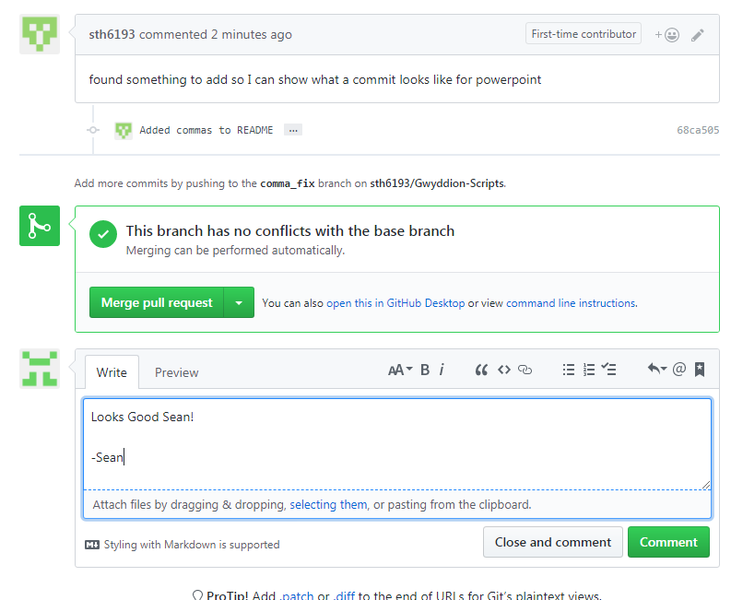
How to Get Code and Contribute
All that is left is for the lab account to approve the changes. This is done by Merging. Merging takes changes from one branch and applies them to another.
It is recommended that you Merge your Branch for the fix/feature with your local master Branch and delete the fix/feature Branch once you are done.

Slide 12
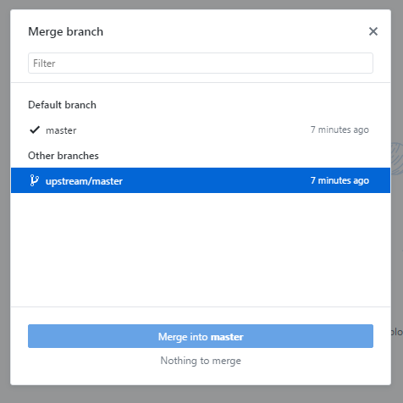
How do I keep my code up to date?
To keep your code up to date with the official version and get changes others have made, you need to Merge your local version with the official version. This can be done via the GitHub desktop. Merge your local master Branch with the upstream\master Branch and the files on your computer will match those online.
Upstream refers to the repository you forked from. The primary branch on the original repository is often referred to as the "upstream", since that is the main place that other changes will come in from.

Slide 13
Where Do I Find our Code?
https://github.com/Madhavanlabcode
I also put in a short tutorial on how to download all the necessary things to use python scripting with Gwyddion. It is in the README of the Gwyddion-Scripts repository.
VC is only successful if people use it, so try to use it! It is also a nice skill to have if you write code in any company/industry or just for self-maintenance
If anyone needs help with GitHub or Gwyddion, I can help. I am learning how to do all this as well.

Slide 14
Useful GitHub Tutorials/Info
https://help.github.com/articles/github-glossary/
https://akrabat.com/the-beginners-guide-to-contributing-to-a-github-project/
https://help.github.com/desktop/guides/
https://try.github.io/levels/1/challenges/1
https://stackoverflow.com/questions/1408450/why-should-i-use-version-control

